Slide 1
Demonstrating the Slow Conduction Zone using Coherent Mapping
Mapping of Scar-Related VT after Inferior Wall Myocardial Infarction

Slide 2
This Presentation and its content is copyright of Arash Arya -
© Arash Arya 2019. All rights reserved.
Any redistribution or reproduction of part or all of the contents in any form is prohibited other than the following:
you may print or download to a local hard disk extracts for your personal and non-commercial use only
you may copy the content to individual third parties for their personal use, but only if you acknowledge the website as the source of the material
You may not, except with our express written permission, distribute or commercially exploit the content. Nor may you transmit it or store it in any other website or other form of electronic retrieval system.

Slide 3
Clinical VT:

Slide 4
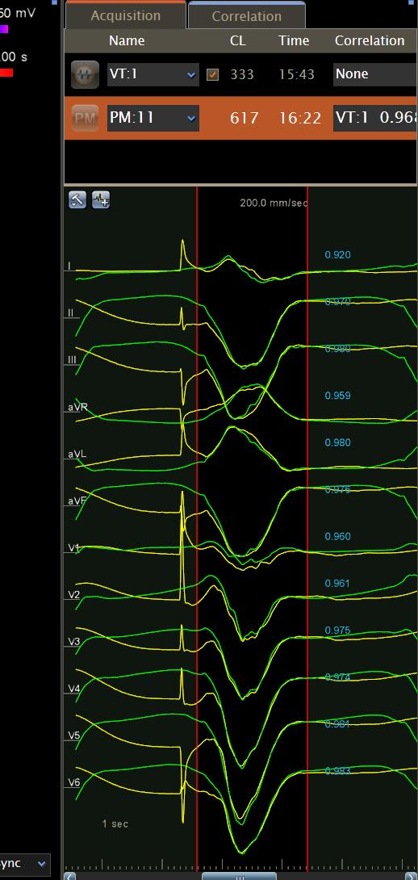
Inferior
LAT
Substrate Mapping

